Slide 1
Metastatic PDAC patient derived xenograft model
Model for drug development & biomarker discovery in metastatic pancreatic cancer
Golan Lab, Sheba Medical Center

Slide 2
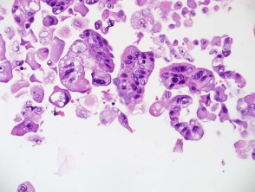
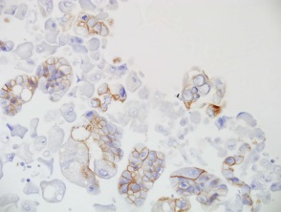
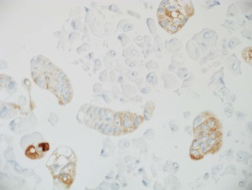
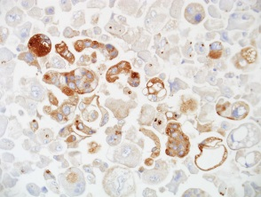
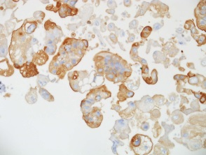
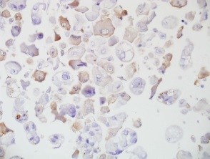
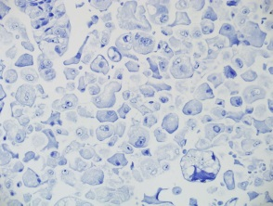
Lab- ongoing
Ascites-derived PDAC primary cultures
In the past year we have obtained 65 ascites cultures from 21 different patients with advanced PDAC
Cultures’ malignancy was confirmed by a gastro-pathologist using cell-block or IHC staining of pan-biomarkers
H&E
Ber-EP4
B72.3
CEA
Muc1
Calrethnin
CK5/6
pt 71.1
All cultures are :
Propagated in-vitro for further experiments
Stored at -80C/liquid Nitrogen for future use
Injected to nude mice for in-vivo experiments
Tested for KRAS/BRCA/p53 mutational status

Slide 3
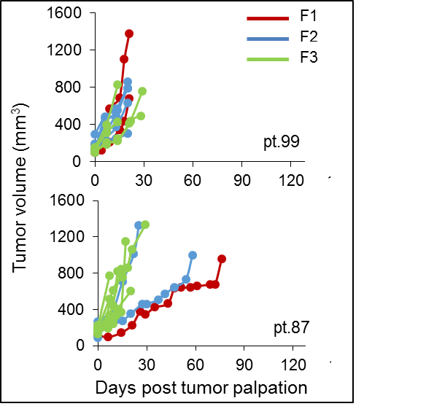
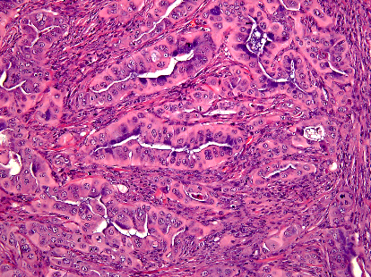
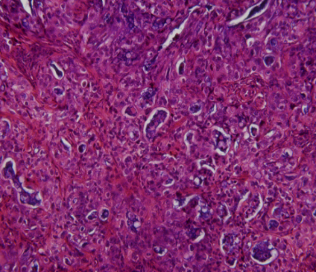
Metastatic PDAC patient derived xenograft models
Ascites and liver core needle biopsies are transplanted to nude mice for generation of metastatic PDX models
PDX1
PDX2
AsPC1
H&E
Poorly to moderately differentiated adenocarcinoma

Slide 4
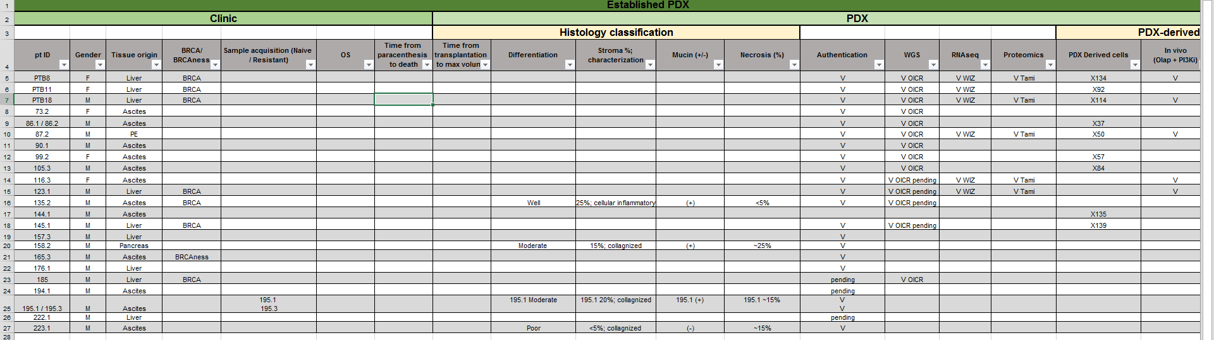
Metastatic PDAC patient derived xenograft models
30 established PDX models (different patients)
~ 8 ongoing
All PDXs are histological classified and compared to diagnostic clinical material (CNBs, FNAs)
All models are authenticated to germline DNA
Generation of PDX derived cultures
Daniel: Histological classification of PDXs
Pancreatic cancer clinical database update (~260 patients up to date)

Slide 5
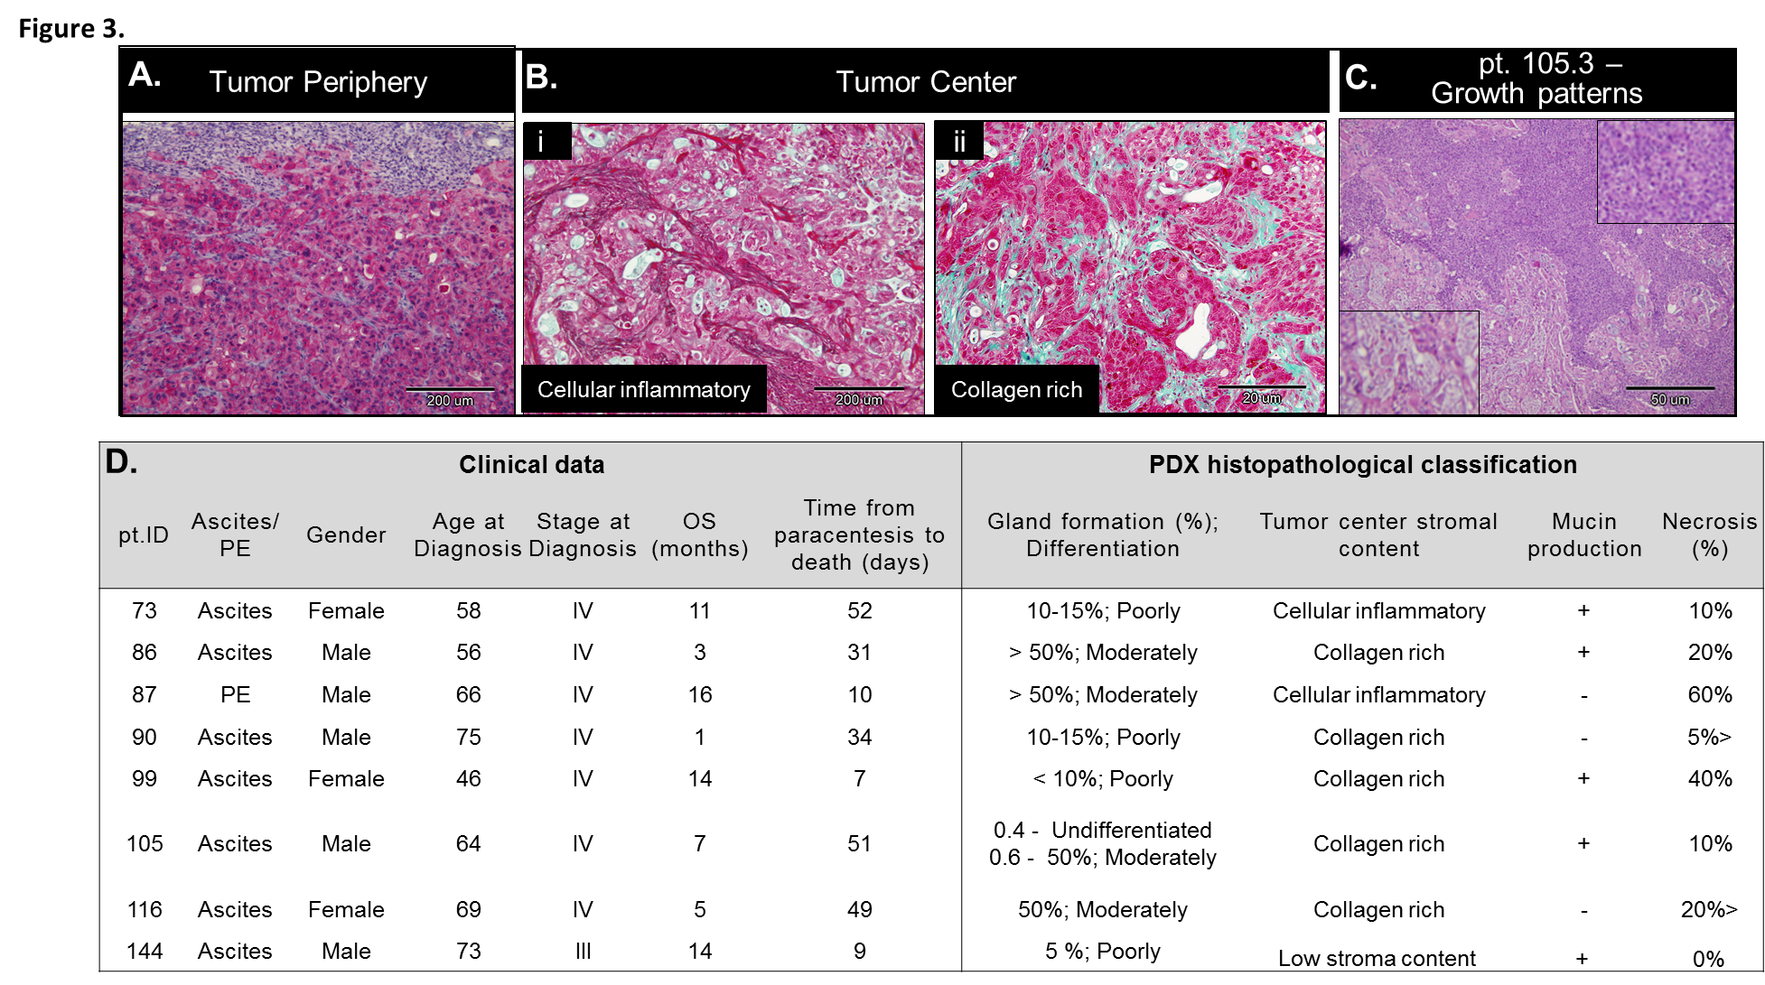
PDAC PDX classification

Slide 6
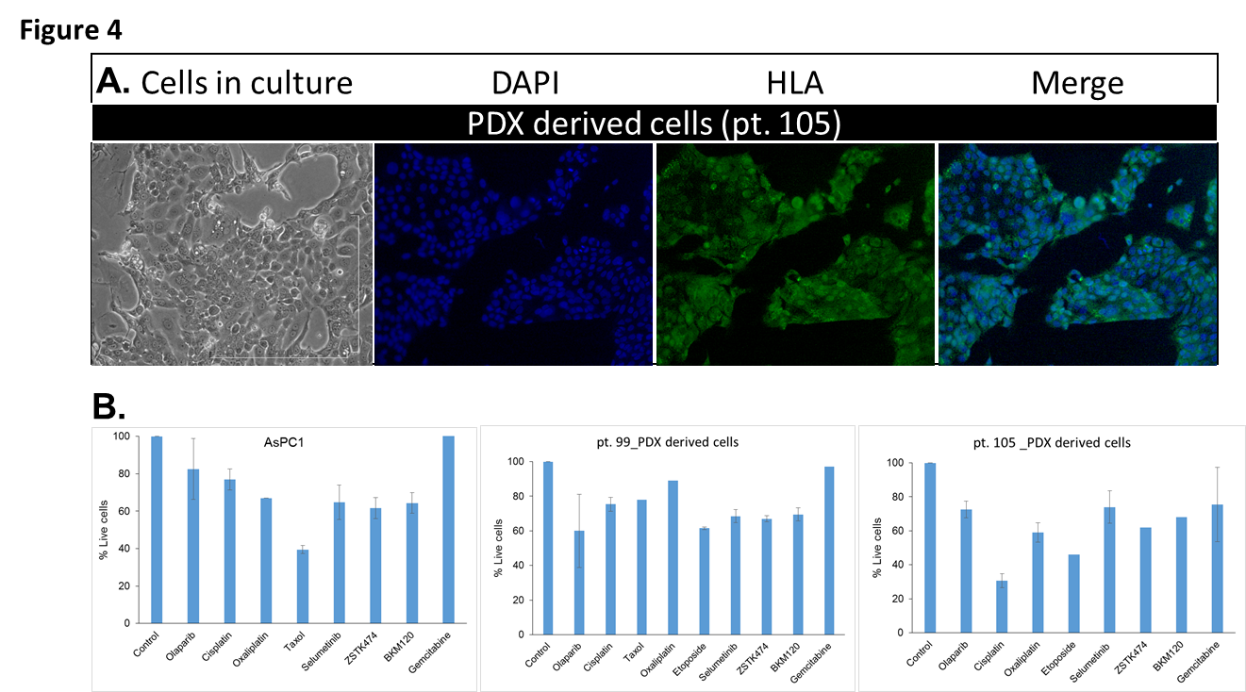
PDAC PDX derived cell cultures and chemo-sensitivity

Slide 7
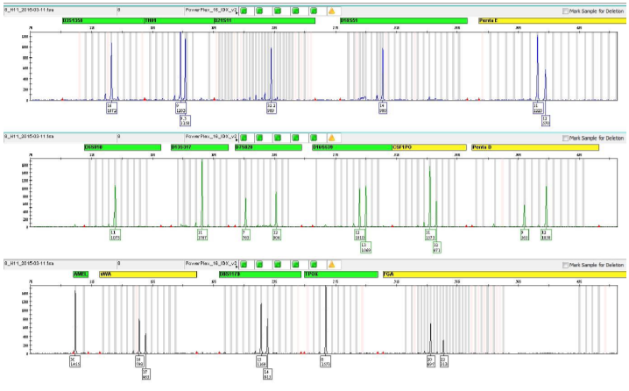
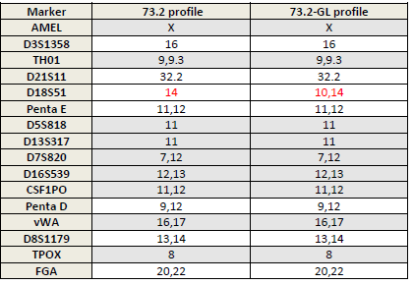
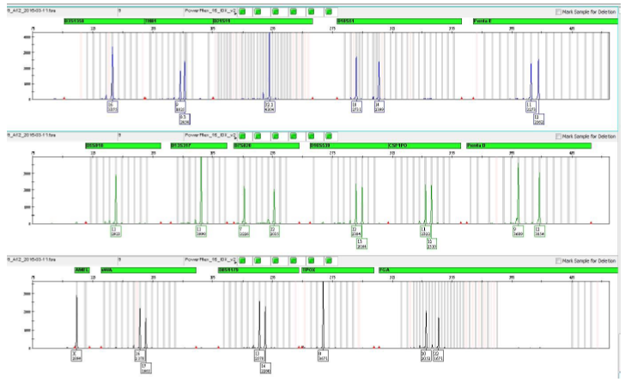
Lab- ongoing
DNA Authentication
S:\Common\Golan Lab\Lab\DNA authentication
..\DNA authentication\DNA Authentication_All samples.xlsx
73.2
73.2-GL
Four paired tumor/ GL DNA + one tumor DNA samples
Results demonstrated LOH in 1- to 7 loci’s in all samples
Two samples demonstrated loss of AMEL Y
These results confirm that our PDX’s where generated from patients tumors cells.

Slide 8
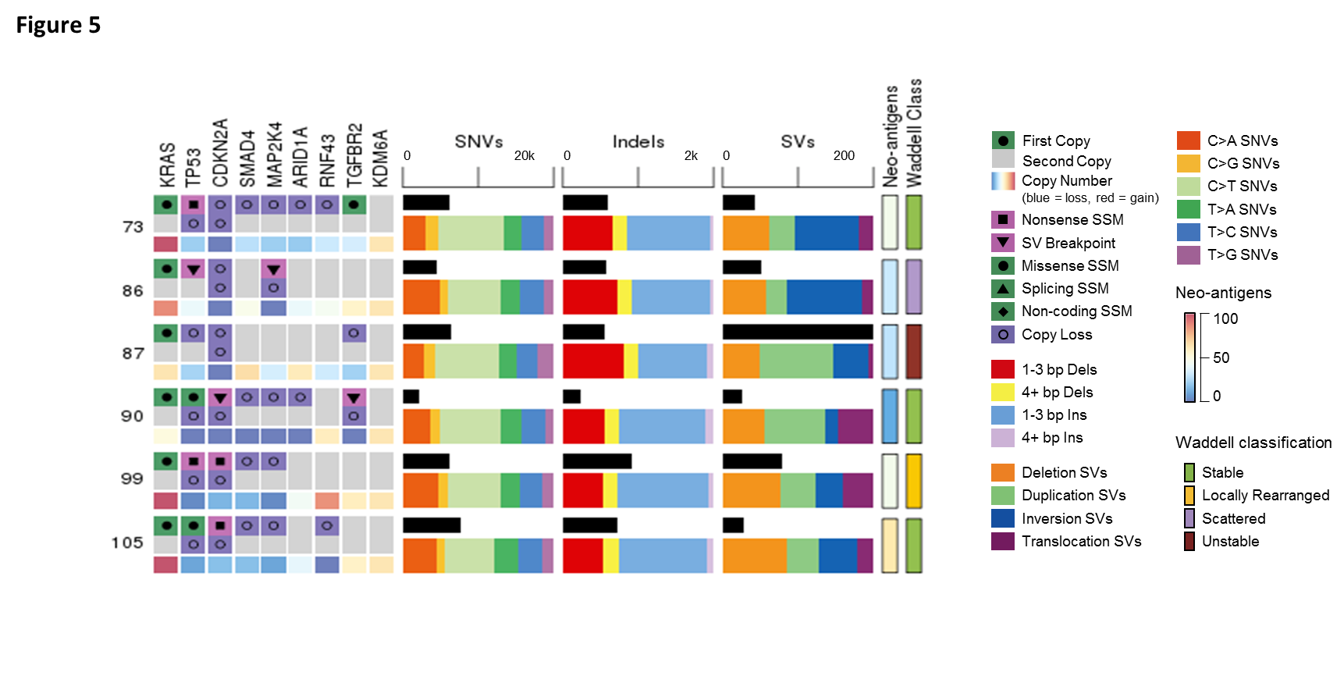
PDAC PDX Genomic classification
Whole genome sequencing

Slide 9
Parallel clinical pre-clinical trial

Slide 10
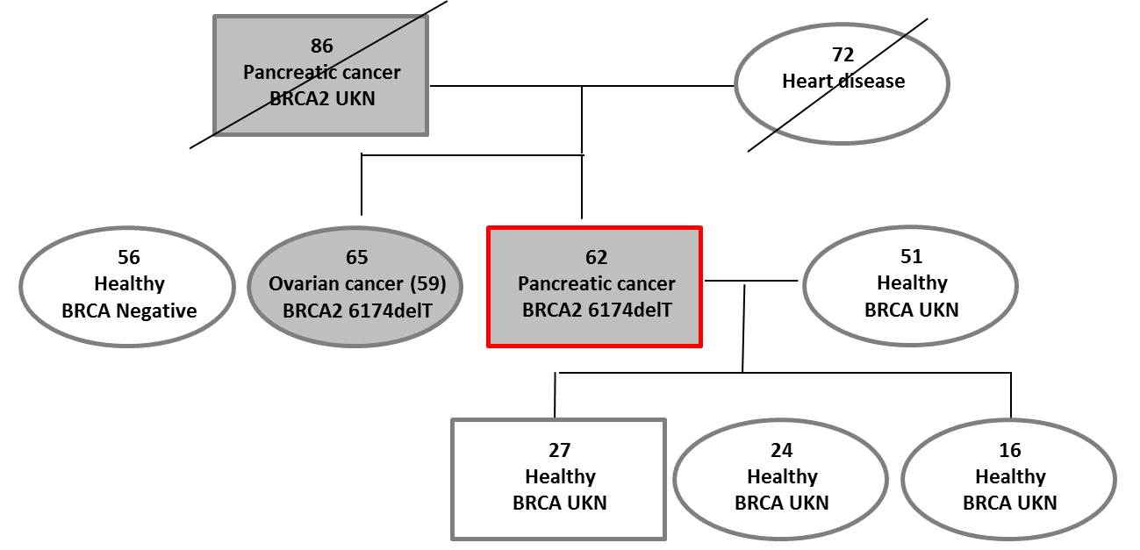
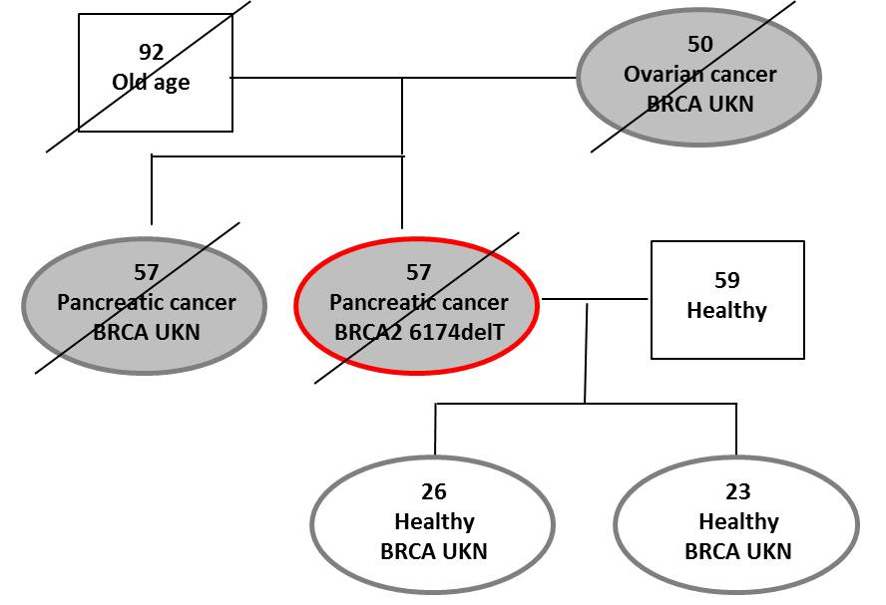
Germ Line BRCA mutation & predisposition to PC
Notes:
Familial clustering is found in ~10% of PC
PC over-represented in families with a clustering of breast and ovarian cancers
In a subset of these cancer-prone families GL BRCA mutations are found

Slide 11
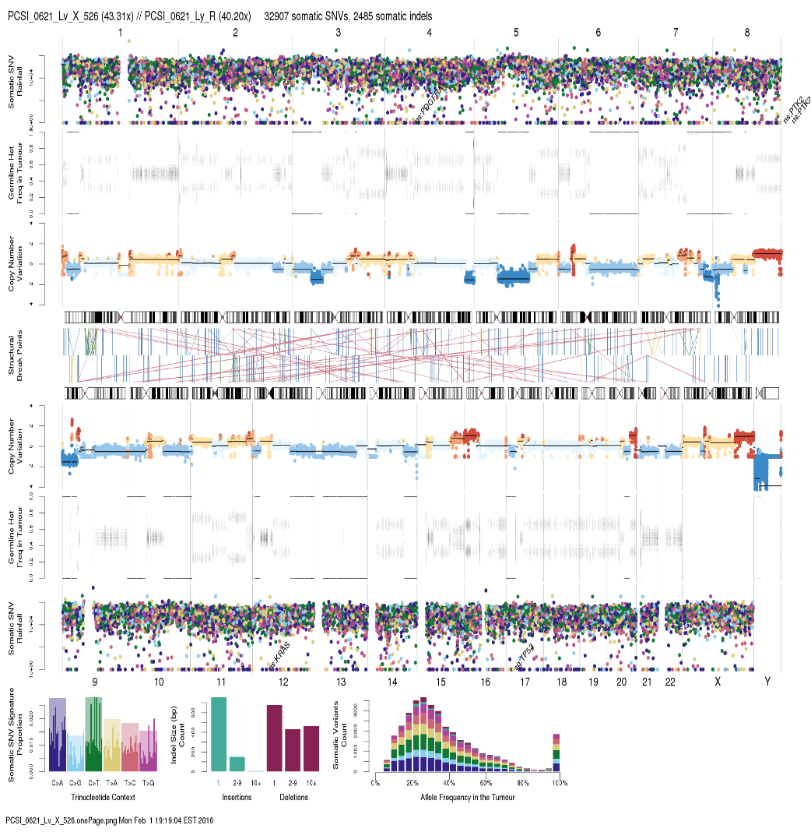
BRCA associated PDAC PDX
62 year old male
2/2014 - Presented with abdominal pain and weight loss
3/2014 – CT – SOL in tail of pancreas and liver lesions
BRCA2 6174delT carrier
05/2014 –04/ 2015: PARPi+ Gemciatbine + Cisplatine treatment – PD;
Core needle biopsy → PDX
05/2015 –6/2015 - Folfirinox *4 + SBRT – PD
09/2015 –12/2015 - Olaparib + single dose Etoposide – PD
1/2016 –5/2016 - MK4166
5/2016 - exitus
32907 alteration
“Unstable” genome
Hits in genes of interest:
KRAS
TP53
PDGFR2
PTK2
PCSI_0621/X75-PTB18
BRCA2: GL Frameshift
BCRA2: Somatic LOH
Core needle biopsy
(Liver metastases)
PDX

Slide 12
PDX AS AN ESTABLISHED IN-VIVO MODEL FOR PANCREATIC CANCER
Daniel Yehuda, Arrow project student

Slide 13
Targeted Treatment-pharmacology
Experiment the new drugs and therapy
Well Established Representing Model
Appropriate treatment for the individual patient
Disease biology
New Targets
Notes:
Slide 13:
In the oncology world there are well known trends that are part of the ‘personalized medicine’ of the future. we want to make the treatment more accurate and less toxic- this is the concept of Targeted treatment.
We want to understand the disease biology- the tumor development, differentiation and metastasis. We would also like to study the tumor -immune relationship and how we can use the immune system against the tumor?
We want to select the appropriate treatment for the individual patient- does my patient’s tumor has the target that I’m aiming against?
We want to find new targets for therapy as well.
And of course we want to be able to conduct experiments with the new drugs we’re developing.
One way to do this is to use a well-established in vivo model, that will represent tumor and the tumors of the whole patients population.
This model, developed and used in Dr. Golan’s lab is the first step in the long way of trying to learn and understand metastatic pancreatic cancer- the genetic heterogeneity, it’s biological and phenotypic characteristics and it’s sensitivity

Slide 14
The model
PDX IN-VIVO MODEL FOR PANCREATIC CANCER
Notes:
Slide 14
As you already heard from Dr. Golan the model used in our lab is a PDX IN-VIVO MODEL FOR PANCREATIC CANCER.
PDX stands for- patient derived xerograph, it means that tumor tissue is taken from a patient and transplanted to a mouse. In our case we are focusing on metastatic disease and use malignant cells from Ascites or liver biopsies. When the tumor grows to a certain size, we take the tumor and transplant to new mice for expansion.

Slide 15
What was the alternative?
“When evaluating our approach to target discovery, we should consider if our current, powerful genomic technologies are being used on model systems that have poor clinical predictive power(…)
(…) The selective pressure of cell culture allows the least differentiated cells to thrive, resulting in distinct and irreversible losses of important biological properties ”
Patient-Derived Tumor Xenografts: Transforming Clinical Samples into Mouse Models
Despina Siolas and Gregory J. Hannon
10.1158/0008-5472.CAN-13-1069 Published September 2013
Notes:
Slide 15-
What was the alternative until the development of PDX in vivo models?
The main research model was monocellular layer cultures of pancreatic tumor cells, and mouse xenografts derived from those cells.
These cells used the researchers for decades but they have under gone genetic draft and de-differentiation. this model is unsatisfying and showed low predictive power. As reviewed in Cancer’ in 2013
“The selective pressure of cell culture allows the least differentiated cells to thrive, resulting in distinct and irreversible losses of important biological properties”
So, we understand that there is need for a model that better recapitulates the tumors and have better predictive power

Slide 16
My Project Aims
To further assist in the establishment and characterization of the PDX model as a preclinical model “mimicking” pancreatic cancer.
To develop a pancreatic cancer clinical data base that will enable a translational study in the future
To investigate the correlation between the clinical disease course and the PDX model characteristics.
Notes:
Slide 16-
After talking about the model and the need in such model, I’ll talk about my project.
As you can see here my project aims are:
To further assist in the establishment and characterization of the PDX model as a preclinical model “mimicking” pancreatic cancer.
To develop a pancreatic cancer clinical data base that will enable a translational study in the future
And to investigate the correlation between the clinical disease course and the PDX model characteristics.

Slide 17
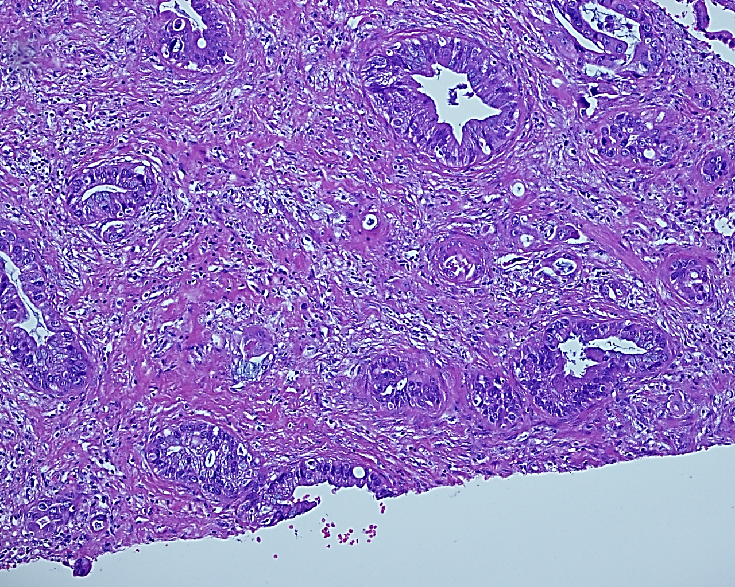
Introduction- PDAC
Notes:
Slide 17- introduction PDAC
Here we see the histology of pancreatic tumor using H+E stain.
The tumor characterize by relatively high percentage of stroma , glands that in generally dictate the differentiation, and the production of mucin.

Slide 18
Methods
Histologically classified 30 first generation PDX.
We created a clinical data base.
Notes:
slide 18-
We decided to concentrate on the first generation PDX’s. Up now we histologically classified 30 first generation established PDX’s.
We used light microscopy and different stains to identify and classify different components in the tumor- such as cells, stroma glands and necrosis.
Using the patient medical filles, we collected the clinical information for the clinical data base

Slide 19
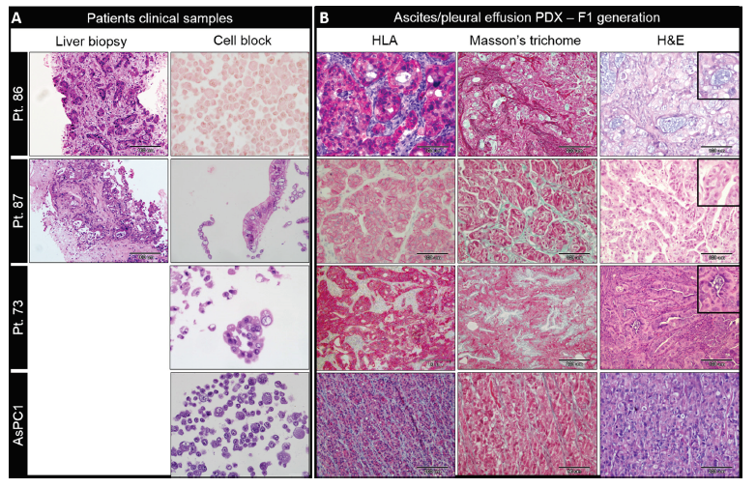
PDAC PDX classification
A.
Pancreatic cancer ascites xenograft – an expeditious model mirroring advanced therapeutic resistant disease. Golan T, Oncotarget, 2017
Notes:
Slide 19–
Here you can see two patients and the established cell line (AsPC1), for each one, we see the H&E slide of the clinical liver metastasis biopsy that was taken at diagnosis. (on the right side of the slide)- These patients received a few lines of chemotherapy and developed ascites/pleural effusion. These malignant cells were used for the generation of the PDX. The pictures under the headline ‘cell block’, show these malignant ascites cells after growing in culture and processed into cell block.
On the left you can see the PDX’s of the same patient H&E, Masson trichom that shows the collagen in stroma and HLA staining to make sure the tumors are human origin.
We also perform STR comparison to germline DNA (from patients white blood cells) to make sure we did not have ant contamination
We see that in comparison to the cultured cells in cell block , the PDX’s is much more similar to the clinical biopsy. The similarity is well emphasis by looking at the architecture of glands formation, the presence of the stroma and the stroma charecterictics and the mucin production- all present in the PDX and in the clinical biopsy.
כן, זה נכון
ואם שואלים אותך – אבל למה צריך את המודל בחיות אם יש את התאים בגידול התרבית? אז התשובה היא שאחוז התאים הסרטנים בתוך כל הנוזל הוא קטן מאד ובcell block אפשר לראות גם הרבה תאי מזותל ויש לימפוציטים וכו. בעצם זה שאנחנו מכניסים את התאים ישירות לחיה אנחנו עושים סלקציה לתאי הסרטן....

Slide 20
PDAC PDX classification
Notes:
Slide 20-
We decided to concentrate on the first generation PDX’s. Up now we histologically classified 30 first generation established PDX’s.
We used light microscopy and different stains to identify and classify different components in the tumor- such as cells, stroma glands and necrosis.
In the table you can see that we classify the tumor differentiation, percentage of stroma and it’s characteristics- for example, is the stroma infiltrated with lymphocytes or is it collagenized. Other characteristics that we classified are the percentage of necrosis or glands forming cells from total tumor cells, the glands differentiation, and whether there is mucin production.
All the parameters that I mentioned help us further validate the model as a representing in vivo model for pancreatic cancer, both in the individual and in the patients population

Slide 21
Clinical data base
Diagnosis- date, stage
Treatment- dates, reaction to tratment, surgery, type of treatment
Past medical history and co morbidity
Well being- hight, whight, sleeping habits
Habits- alchohol use, drug use, phisical activity
Family history
BRCA status
Overall survival
Notes:
slide 21
Using the patient medical filles, we collected information about their past medical history, family history, treatments and their reaction to treatment, BRCA status and overall survival.

Slide 22
Example
Notes:
Slide 22-
After you’ve heard about my project targets and methods I want to show you a small taste from the outcome.
In this table -for each patient we gathered the main clinical features from the data base we’ve created with the histological classification of his PDX.
The end result gives us the whole picture-
The merge of the clinical data with histological data that will enable future investigation of correlation between the clinical disease course and the PDX model characteristics.

Slide 23
Core needle biopsy
(Liver metastases)
PDX
Notes:
This is an example of one patient and the whole picture that we gather- the clinical course next to the PDX’s – in the future we hope this will enable the translational study.

Slide 24
Ongoing..
Expand the model size
Expand the data base size
Further charicterisation of the model- histologically comparison of first generation PDX vs. clinical biopsy used to diagnosis.
Clinical correlation between the overall survival / Progression-free survival and the histological fetures of the PDX model.
Notes:
Slide 24
My project is still on going and the plan is to expand the project size- the data base and the classification of the PDX’s.
8 more PDX’s are ready to be classified and more already transplanted to mice- so I have plenty of work to do! :-)
Another process that is taking place right now is the histologic comparison between the first generation PDX’s and the clinical biopsy used for initial diagnosis- in order to continue and make further characterization of the model.
This comparison will also help us understand whether the PDX can fully represent the individual person.
Personally And what interests me the most is the third goal of my project that I haven't achieved yet- we want to investigate the correlation between the clinical disease course and the PDX model characteristics.
so I hope to update you next year with our progress.

